Slide 1
IBM Cloud Pak For Applications
Overview
Key offerings included with IBM Cloud Pak for Applications
Cloud Native Application Development Flow
Demo
Summary

Slide 2
IBM Cloud Paks
Overview
IBM Cloud® Paks are enterprise-ready, containerized software solutions that give clients an open, faster and more secure way to move core business applications to any cloud. Each IBM Cloud Pak® includes containerized IBM middleware and common software services for development and management.
Consistent added capabilities for deployment, lifecycle management, and production quality of service – logging, monitoring, version upgrade and roll-back, vulnerability assessment and testing.
Designed to run anywhere, on public clouds, on premises or on a private cloud .

Slide 3
IBM Cloud Paks
IBM Cloud Pak® for Applications It offers cloud-native development solutions to quickly build, test, deploy application. develop new apps or modernize existing applications.
IBM Cloud Pak® for Data is a fully-integrated data and AI platform that modernizes how businesses collect, organize and analyze data and infuse AI throughout their organizations.
IBM Cloud Pak® for Integration comes pre-integrated with a set of capabilities including API lifecycle, application and data integration, messaging and events, high-speed transfer and integration security.
IBM Cloud Pak® for Automation is design, build and run automation applications and services on any cloud where Kubernetes is supported , using pre-integrated automation technologies and low-code tools.
IBM Cloud Pak® for Multicloud Management is an application-centric, AI infused platform for IT automation designed to provide full visibility and control
IBM Cloud Pak® for Security helps to uncover hidden threats, make informed decisions about the risks they pose, and then respond faster to those threats — while leaving data where it is.

Slide 4
IBM Cloud Pak For Applications
Key offerings included with IBM Cloud Pak for Applications
IBM Cloud Pak for Applications provides several software offerings in one bundle. You can choose to deploy some or all the purchased software.
IBM Accelerators for Teams
Enterprise-ready and fully supported implementation of the Kabanero open source community project.
Generate required source with scaffolded microservices that are continuously built in containers.
Kabanero:- Kabanero offers open source technologies in a microservices-based framework that simplifies development, build, and deployment of applications for both Kubernetes and Knative (serverless).
Appsody:- offers pre-defined/custom code stacks that minimize the initial effort of creating a project.
CodeWind:- is an IDE extension that can be used to build, test, and deploy applications within containers (right now there’s support for Eclipse, Eclipse Che, and VSCode), you don’t even have to be familiar with container environment.
Tekton:- The Tekton project provides Kubernetes-style resources for declaring CI/CD-style pipelines.
Knative:- Knative is an open source software layer for running serverless containers on Kubernetes.
IBM Cloud Transformation Advisor
With IBM Transformation Advisor, you can determine which WebSphere® applications to move to the cloud and gain insights into how to accelerate your move to the cloud.
After you upload the results of the data collector, you can review recommendations for migrating your applications to different cloud platforms and the estimated complexity (simple, medium, complex) .
Notes:
Kabanero stack, Kabanero Operator, Local hub,.

Slide 5
IBM Cloud Pak For Applications
Key offerings included with IBM Cloud Pak for Applications
IBM Application Navigator
Tool that helps you visualize, inspect, and monitor the deployed resources in applications, with a single view across hybrid deployments.
IBM WebSphere Application Server
WebSphere Application Server, with its traditional and Liberty runtimes, offers production-ready, standards-based Java™ EE compliant architectures.
IBM Mobile Foundation
Rapidly build and deploy the next generation of digital apps, including mobile, wearables, conversation, web, and PWAs. With Mobile Foundation, developers get containerized mobile back-end services covering comprehensive security, application lifecycle management, push notifications, feature toggle, offline sync, and back-end integration.

Slide 6

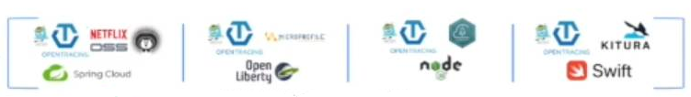
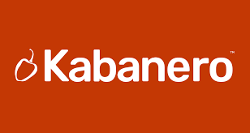
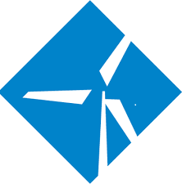



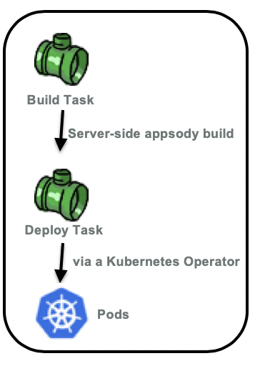
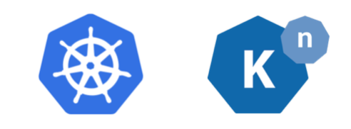
Cloud Native Application Development Flow on IBM Cloud Pak For Applications (CP4Apps)
Create
Architect
Architect creates customized application Stack mange by Kabanero
Technology stack
Developers discover require Stack
Run
Test
Debug
Appsody CLI
IDE
Appsody CLI
Appsody init
Developer
Dev App
Save Changes
Codewind IDE
Git Project ( webhook )
Dev App
Git Commit
Appsody deploy CLI
Build Microservice
Cloud Platform
Notes:
https://github.com/appsody/stacks/tree/master/incubator/java-spring-boot2

Slide 7
Demo
Set up Dev tools.
- Install Appsody, Codewind.
Initialize, build, run Application Locally.
- initialize project, run/debug locally (containerized application)
Deploy to IBM Cloud Pak.
- Tekton pipeline (Firewall issue , private cluster: not able to connect from public sites)
- Appsody command.
>appsody deploy --push-url <> --push -- pull-url --namespace kabanero-samples1

Slide 8
Summary
IBM Cloud Pak
- Overview, Subpacks
Cloud Pak for Application offerings.
- IBM Accelerators, Transformation Advisor, Application Navigator.
Cloud-Native development flow.
- Appsody Stack, Codewind, Tekton.
- Architects, Developers, Devops.
Demo
- Appsody CLI, Codewind, application navigator.

Slide 9
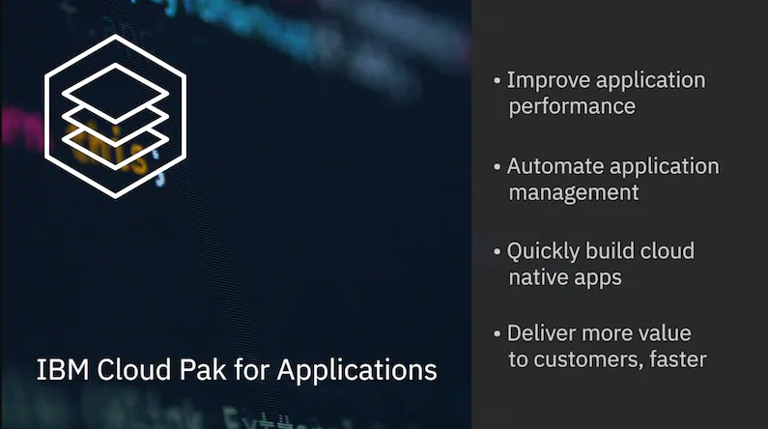
Thank You

